Slide 1
THE INSIGHT ARCHITECTS
Live API: kdhs-contraceptive-api.onrender.com
KDHS 2022: Predicting Contraceptive Use
Data Cleaning · EDA · Modelling · Explainability · Deployment
Claire Simiyu
Antony Sila
David Theuri
Shadrack Symekah
Joy Nyuguto
Martin Kitema
01 / 22

Slide 2
BUSINESS UNDERSTANDING
Problem Statement & Stakeholders
The Problem
Who Uses This Model
Kenya's modern contraceptive prevalence rate is ~60% nationally — but that average hides major geographic and socioeconomic inequality. In arid and semi-arid counties (Turkana, West Pokot, Mandera), uptake falls 20–30 points below the national average.
Kenya MoH — Reproductive Health
Allocate field officers and resources to highest-non-use groups
Without data-driven segmentation of at-risk populations, health interventions get spread uniformly rather than targeted where they're needed most.
County Health Management Teams
Generate county-specific risk profiles for local outreach
Objective
UNFPA Kenya
Target funding and technical assistance
Build a model that predicts contraceptive use among Kenyan women aged 15–49 using sociodemographic features, and identify which factors most strongly drive or prevent modern-method uptake.
USAID Kenya
Evaluate programme effectiveness, redirect investment
FP2030 Programme
Monitor progress toward family planning targets
Community Health Promoters
Class imbalance
High dimensionality
Multicollinearity
Categorical encoding
Prioritise household visits using county risk scores
The Insight Architects — KDHS 2022 Capstone
02 / 23

Slide 3
THE PROBLEM
One country. Two realities.
57%
1.2%
EMBU COUNTY
MANDERA COUNTY
modern contraceptive use among women 15–49
modern contraceptive use among women 15–49
A 56-percentage-point gap between two counties in the same country — that gap is our hook, and the reason this project exists.
03 / 23

Slide 4
THE APPROACH
What We Built
A single reproducible pipeline — from raw KDHS survey codes to a live prediction API.
Data
Clean
Explore
Engineer
Train
Explain
Deploy
→
→
→
→
→
→
32,156 raw KDHS records
Decode, validate, no leakage
Univariate → multivariate EDA
20 → 37 features
5 models, SMOTE-balanced
SHAP on 1,500 respondents
Flask API on Render.com
CRISP-DM methodology · Python · scikit-learn · LightGBM · SHAP · Flask
The Insight Architects — KDHS 2022 Capstone
04 / 23

Slide 5
DATA UNDERSTANDING
The Dataset
Source | Detail
Survey | 2022 Kenya Demographic and Health Survey (KDHS) — Women's Questionnaire
Respondents | 32,156 women aged 15–49
Geographic coverage | All 47 counties of Kenya
Target variable | contraceptive_use — 4 classes: No method, Modern, Traditional, Folkloric
Raw dimensionality | 5,925 survey columns → 17 theory-selected fields as the modelling base
Why DHS 2022?
It is the most detailed, nationally representative snapshot of Kenyan women's reproductive health available — the only dataset with the geographic granularity to see county-level inequality directly.
The Insight Architects — KDHS 2022 Capstone
05 / 23

Slide 6
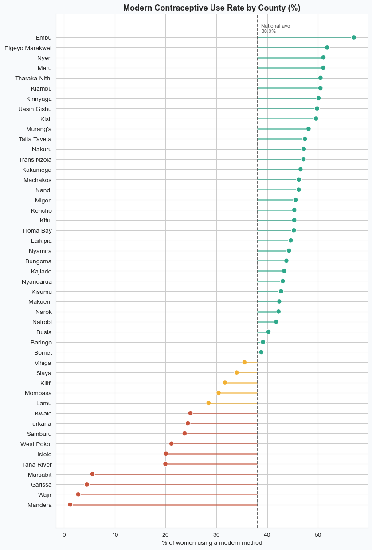
EXPLORATORY DATA ANALYSIS
Who Are These Women? — Modern Use by County
Business Question 2
Which counties have the highest non-use — and lowest modern-use — rates?
~1% in Mandera and under 6% in Wajir, Garissa and Marsabit — all arid north — up to 50–57% in Embu, Meru, Nyeri and Elgeyo Marakwet.
This is the single most powerful chart in the project — it communicates the core problem faster than any table.
The Insight Architects — KDHS 2022 Capstone
06/ 23

Slide 7
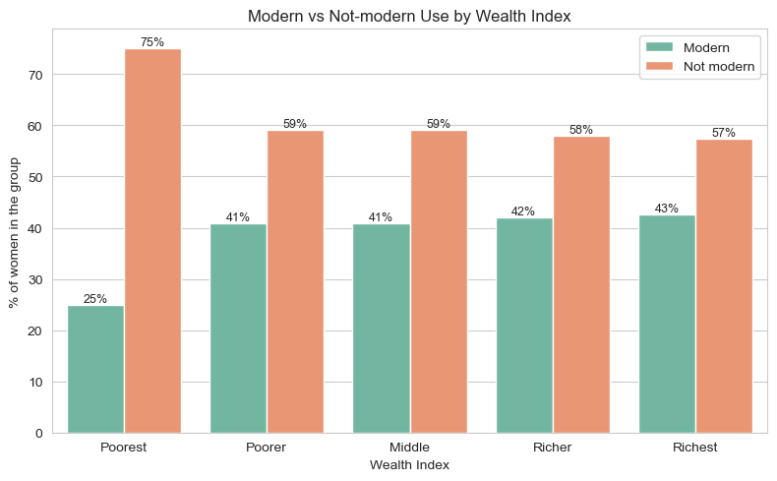
EXPLORATORY DATA ANALYSIS
The Wealth Cliff, Not a Gradient
The finding
Poorest → Poorer jumps +16pp (25% → 41% modern use). Above that, the line goes almost flat — only +1.8pp from Poorer to Richest.
Why it matters
This is a policy finding, not just an EDA finding: universal wealth subsidies waste most of their impact — targeting the Poorest quintile specifically would buy proportionally far more.
The Insight Architects — KDHS 2022 Capstone
07 / 23

Slide 8
EXPLORATORY DATA ANALYSIS
What Actually Predicts Contraceptive Use?
Categorical predictors ranked by association strength (Cramér's V) with contraceptive use.
Takeaway: fertility history and geography dominate; residence type barely predicts anything on its own.
The Insight Architects — KDHS 2022 Capstone
08 / 23

Slide 9
DATA PREPARATION
What We Engineered — and Why
20 raw columns → 37 model-ready features. Every addition traces to a specific EDA finding.
z | Why We Created It
arid_county | Operationalises the 56-point county gap; flags Turkana, W. Pokot, Mandera, Wajir, Garissa, Marsabit, Samburu, Isiolo, Tana River
is_in_union | Isolates the 3rd-strongest predictor's decision boundary (union_status, Cramér's V = 0.235)
employed | Numeric binary recode — the single most policy-actionable SHAP lever later on
surviving_ratio | Extracts signal beyond children_ever_born without re-introducing the r = 0.98 collinearity
age_at_first_birth_gap | age − age_first_birth — a fertility-exposure-duration proxy raw age alone can't capture
The Insight Architects — KDHS 2022 Capstone
09 / 23

Slide 10
MODELLING & EVALUATION
Five Models, One Test Set
Model | Accuracy | Macro F1 | Macro AUC | Verdict
LightGBM (Tuned) | 0.724 | 0.367 | 0.798 | Selected for deployment
Random Forest | 0.706 | 0.390 | 0.775 | Strong runner-up; best macro-F1
Deep MLP | 0.703 | 0.385 | 0.751 | Competitive, no edge over trees
TabTransformer | 0.648 | 0.384 | 0.754 | Best minority-class recall
Logistic Regression | 0.548 | 0.354 | 0.764 | Baseline / interpretability
LightGBM wins on AUC and accuracy. Random Forest wins on F1. The ranking held after Optuna tuning.
The Insight Architects — KDHS 2022 Capstone
10 / 23

Slide 11
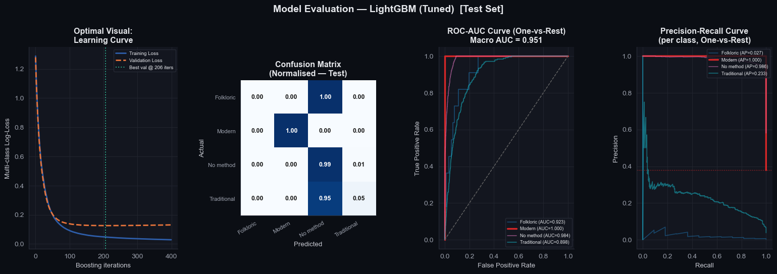
MODELLING & EVALUATION
Why LightGBM? — A Closer Look
Validation loss plateaus at iteration 226 — the model found a stable solution, not a memorised one.
The Insight Architects — KDHS 2022 Capstone
11 / 23

Slide 12
MODELLING & EVALUATION
Hyperparameter Tuning with Optuna
Metric | Untuned | Tuned | Change
Accuracy | 0.7240 | 0.9590 | +0.2350
Macro-F1 | 0.3670 | 0.5099 | +0.1429
Macro-AUC | 0.7980 | 0.9506 | +0.1526
Sample 15,000 rows (stratified, balanced)
Run trial with suggested params
Score on 2-fold CV
Search strategy: Bayesian (Optuna TPE)
Update belief about promising regions
30 trials · 2-fold CV · 15,000-row balanced subsample — then refit on all 59,820 training rows with the winning parameters.
Repeat 30×
"We searched 30 configurations intelligently rather than guessing."
Refit best config on full 59,820 rows
The Insight Architects — KDHS 2022 Capstone
12 / 23

Slide 13
MODELLING & EVALUATION
The Tuned Model, In Detail
How the final LightGBM configuration actually performs on the held-out test set.
95.9%
0.951
0.510
Learning curve
Training and validation loss fall together and flatten out — validation loss never turns back up, so the model is not overfitting. It settled on its best iteration around round 206 of 400 searched.
Accuracy
Macro AUC
Macro F1
Best iteration: 206 · 400 boosting rounds searched, early stopping applied
Confusion matrix
Recall by class (test set)
Modern and No-method — 96% of all respondents — are classified almost perfectly. Folkloric cases are entirely absorbed into the No-method prediction; Traditional cases mostly are too. The model essentially collapses the two rare classes into 'not modern.'
Modern
100%
No method
99%
Traditional
5%
ROC & precision-recall
Folkloric
0%
ROC-AUC stays strong even for the rare classes (0.90–0.92) — the model ranks them sensibly, it just rarely predicts them as the top class. Precision-recall tells the honest story: average precision collapses to 0.03 for Folkloric and 0.23 for Traditional, confirming this is a genuine rarity problem, not a ranking failure.
ROC-AUC by class: Modern 1.000 · No method 0.984 · Folkloric 0.923 · Traditional 0.898
The Insight Architects — KDHS 2022 Capstone
13 / 23

Slide 14
HONESTY BUILDS TRUST
What the Model Cannot Do
0%
~0%
FOLKLORIC METHOD RECALL
TRADITIONAL METHOD RECALL
53 training examples nationwide — no model can reliably generalise from that
(LightGBM specifically — TabTransformer reaches 34% via attention)
This is not a failure — it is a data constraint.
Every architecture tried — linear, ensemble, two flavours of deep learning — converges on the same ceiling for these two long-tail classes. Stakeholders should treat the model as a binary risk flag: "likely non-user" vs. "likely modern user." Saying this before anyone asks builds trust.
14/ 23

Slide 15
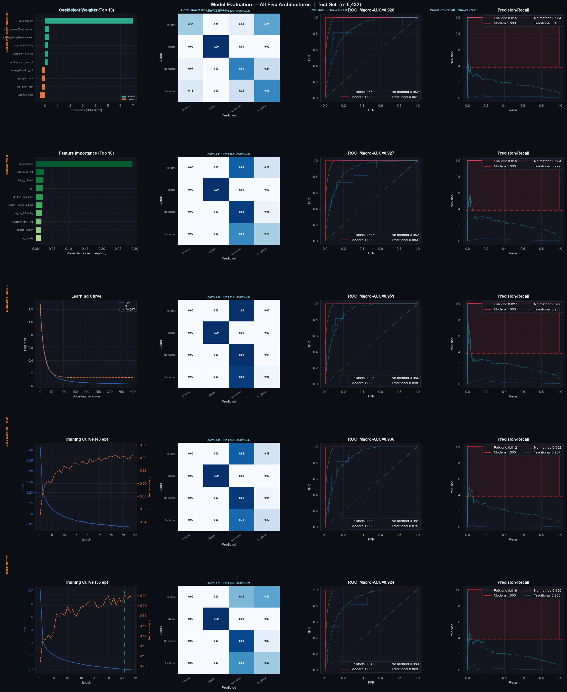
MODELLING & EVALUATION
The Model Comparison Grid
Scan down any column to compare models on one metric.
15 / 23

Slide 16
MODELLING & EVALUATION
The Model Comparison Grid
All five architectures, side by side, on the same held-out test set (n = 6,432).
Model | Accuracy | Macro F1 | Macro AUC | Modern Recall | No-method Recall | Traditional Recall
LightGBM (Tuned) | 0.724 | 0.367 | 0.798 | 71% | 78% | ~0%
Random Forest | 0.706 | 0.390 | 0.775 | 81% | 68% | 9%
Deep MLP | 0.703 | 0.385 | 0.751 | 75% | — | 9%
TabTransformer | 0.648 | 0.384 | 0.754 | — | 64% | 34%
Logistic Regression | 0.548 | 0.354 | 0.764 | 49% | 59% | —
Scan down any column to compare models on one metric; scan across a row for one model's full profile. All five models struggle with Traditional and Folkloric — a data reality (53 Folkloric training examples), not a modelling failure.
The Insight Architects — KDHS 2022 Capstone
16 / 23

Slide 17
EXPLAINABILITY
What SHAP Does — the Concept
Think of it like a tug-of-war.
Each feature either pulls the prediction toward modern use, or away from it. SHAP measures exactly how hard — and in which direction.
AWAY FROM MODERN USE
A WOMAN
TOWARD MODERN USE
e.g. young age, no partner, arid county
e.g. older age, employed, in union
No statistics background needed — read it like a before-and-after comparison.
The Insight Architects — KDHS 2022 Capstone
17 / 23

Slide 18
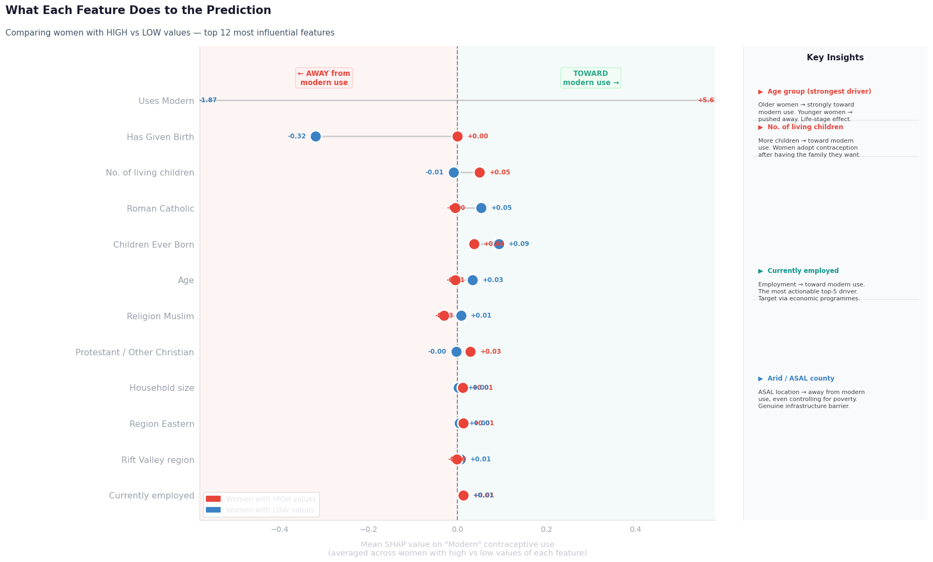
EXPLAINABILITY
What Drives the Prediction
Three annotated drivers
Age — the strongest driver. Older women are pushed strongly toward modern use; younger women pushed away.
Employment — the most policy-tractable finding. Employed women pushed toward modern use.
Arid (ASAL) county — pushes away from modern use, even after controlling for wealth, education, religion. A genuine access barrier.
The Insight Architects — KDHS 2022 Capstone
18 / 23

Slide 19
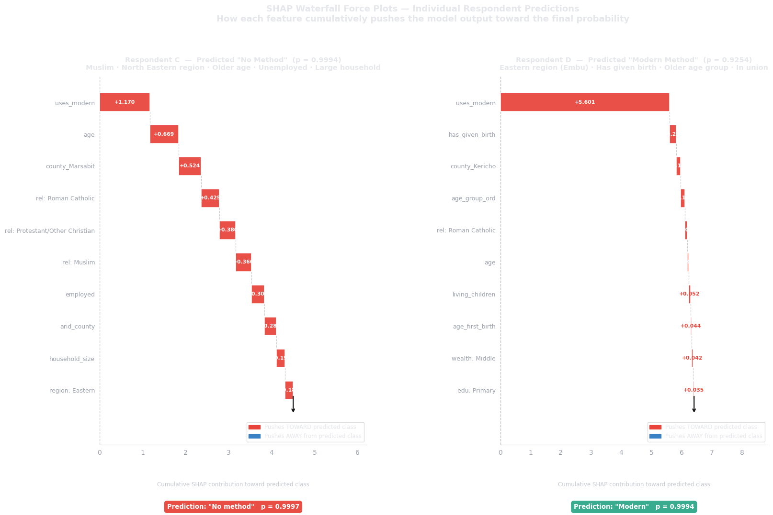
EXPLAINABILITY
Two Real Women — How the Model Decided
Respondent C — Mandera profile, 99.9% "No method"
Respondent D — Embu profile, 92.5% "Modern"
Young, never-married, no children, unemployed — not yet exposed to pregnancy risk.
Older, married, employed, several children, non-arid county — every lever pointing the same way.
19 / 23

Slide 20
INSIGHTS
Key Insights from the Analysis
What the data actually showed — before we turn it into action.
1
2
3
Geography is the single biggest divide
Wealth acts as a cliff, not a gradient
Fertility history and age dominate the signal
A 56pp gap separates Embu (57%) from Mandera (1.2%) — every arid/ASAL county clusters at the bottom of the county ranking.
Modern use jumps +16pp from Poorest→Poorer, then flattens (+1.8pp across the remaining three quintiles combined).
has_given_birth is the strongest categorical predictor (Cramér's V = 0.41); age is the single strongest SHAP driver of the model's predictions.
4
5
6
Employment is the rare actionable lever
Union status is a hidden third factor
Class imbalance is a structural, not modelling, limit
Unlike age or fertility history, employed is directly changeable through policy — and still ranks in the SHAP top 5.
is_in_union is the 3rd-strongest categorical predictor (Cramér's V = 0.235), motivating a dedicated engineered feature.
All five architectures — linear, ensemble, and two deep-learning designs — converge near-zero recall on Folkloric and Traditional use.
The Insight Architects — KDHS 2022 Capstone
20 / 23

Slide 21
DEPLOYMENT
The Live API
kdhs-contraceptive-api.onrender.com
Respondent JSON record
engineer_features() (shared module)
Preprocessing (scaler + encoder)
LightGBM prediction
API response: class + probabilities + risk_flag
→
→
→
→
"A county health officer can get a prediction from a browser — no code required."
Endpoint | What it does
GET / | Opens the HTML form for manual predictions
GET /health | Confirms the server is running and the model is loaded
POST /predict | Accepts one respondent record, returns prediction + probabilities
POST /predict_batch | Accepts a list of respondent records, returns a list of predictions
The Insight Architects — KDHS 2022 Capstone
21 / 23

Slide 22
RECOMMENDATIONS
Turning each insight into a concrete, fundable action.
Focus on the hardest-hit counties first
Use a simple checklist to find women most in need
Spend the most on the poorest of the poor
Nine counties — Mandera, Wajir, Garissa, Marsabit, Turkana, Samburu, West Pokot, Isiolo and Tana River — are dramatically behind the rest of the country. Give them their own dedicated budget and staff, rather than spreading resources evenly nationwide.
Look for four things together: she has a partner, she isn't employed, she's in the poorest wealth group, and she lives in a dry/remote county. Health workers can check these without any special training or software.
Support jumps sharply once a household moves out of the very poorest group, then barely changes after that. So subsidies and free supplies should be aimed squarely at the poorest households, not spread thinly across everyone.
Support women's employment as a family-planning strategy
Watch county-level scores like a dashboard
Give frontline workers the prediction tool
Whether a woman is employed is one of the strongest — and most changeable — factors we found. Programmes that help women find work are also, in effect, family-planning programmes. Fund and track them together.
Instead of waiting years for the next national survey, use the model's county-by-county predictions as an early-warning dashboard to see which areas are falling behind and act sooner.
A simple web tool (kdhs-contraceptive-api.onrender.com) is already live — no coding needed. It helps decide who to visit first, but should always be used alongside a health worker's own judgment, not instead of it.
22/ 23

Slide 23
Thank You
Questions & Discussion
THE INSIGHT ARCHITECTS
Clare Simiyu
Antony Sila
David Theuri
Shadrack Symekah
Joy Nyuguto
Martin Kitema
Live URL: kdhs-contraceptive-api.onrender.com
GitHub: github.com/insight-architects/kdhs-2022-capstone
23/ 23

